Slide 1
Week4Tasks
Yumi Verma

Slide 2
Task 1
Assuming a = 5, b = 4, c = 3, indicate whether each of the following conditions
resolve to true or false:
a) (a < b) False
b) (a != b) True
c) (a > b) and (a < c) False
d) (a > b) or (a < c)
e) (a – 1 == b)
f) not(b > c)

Slide 3
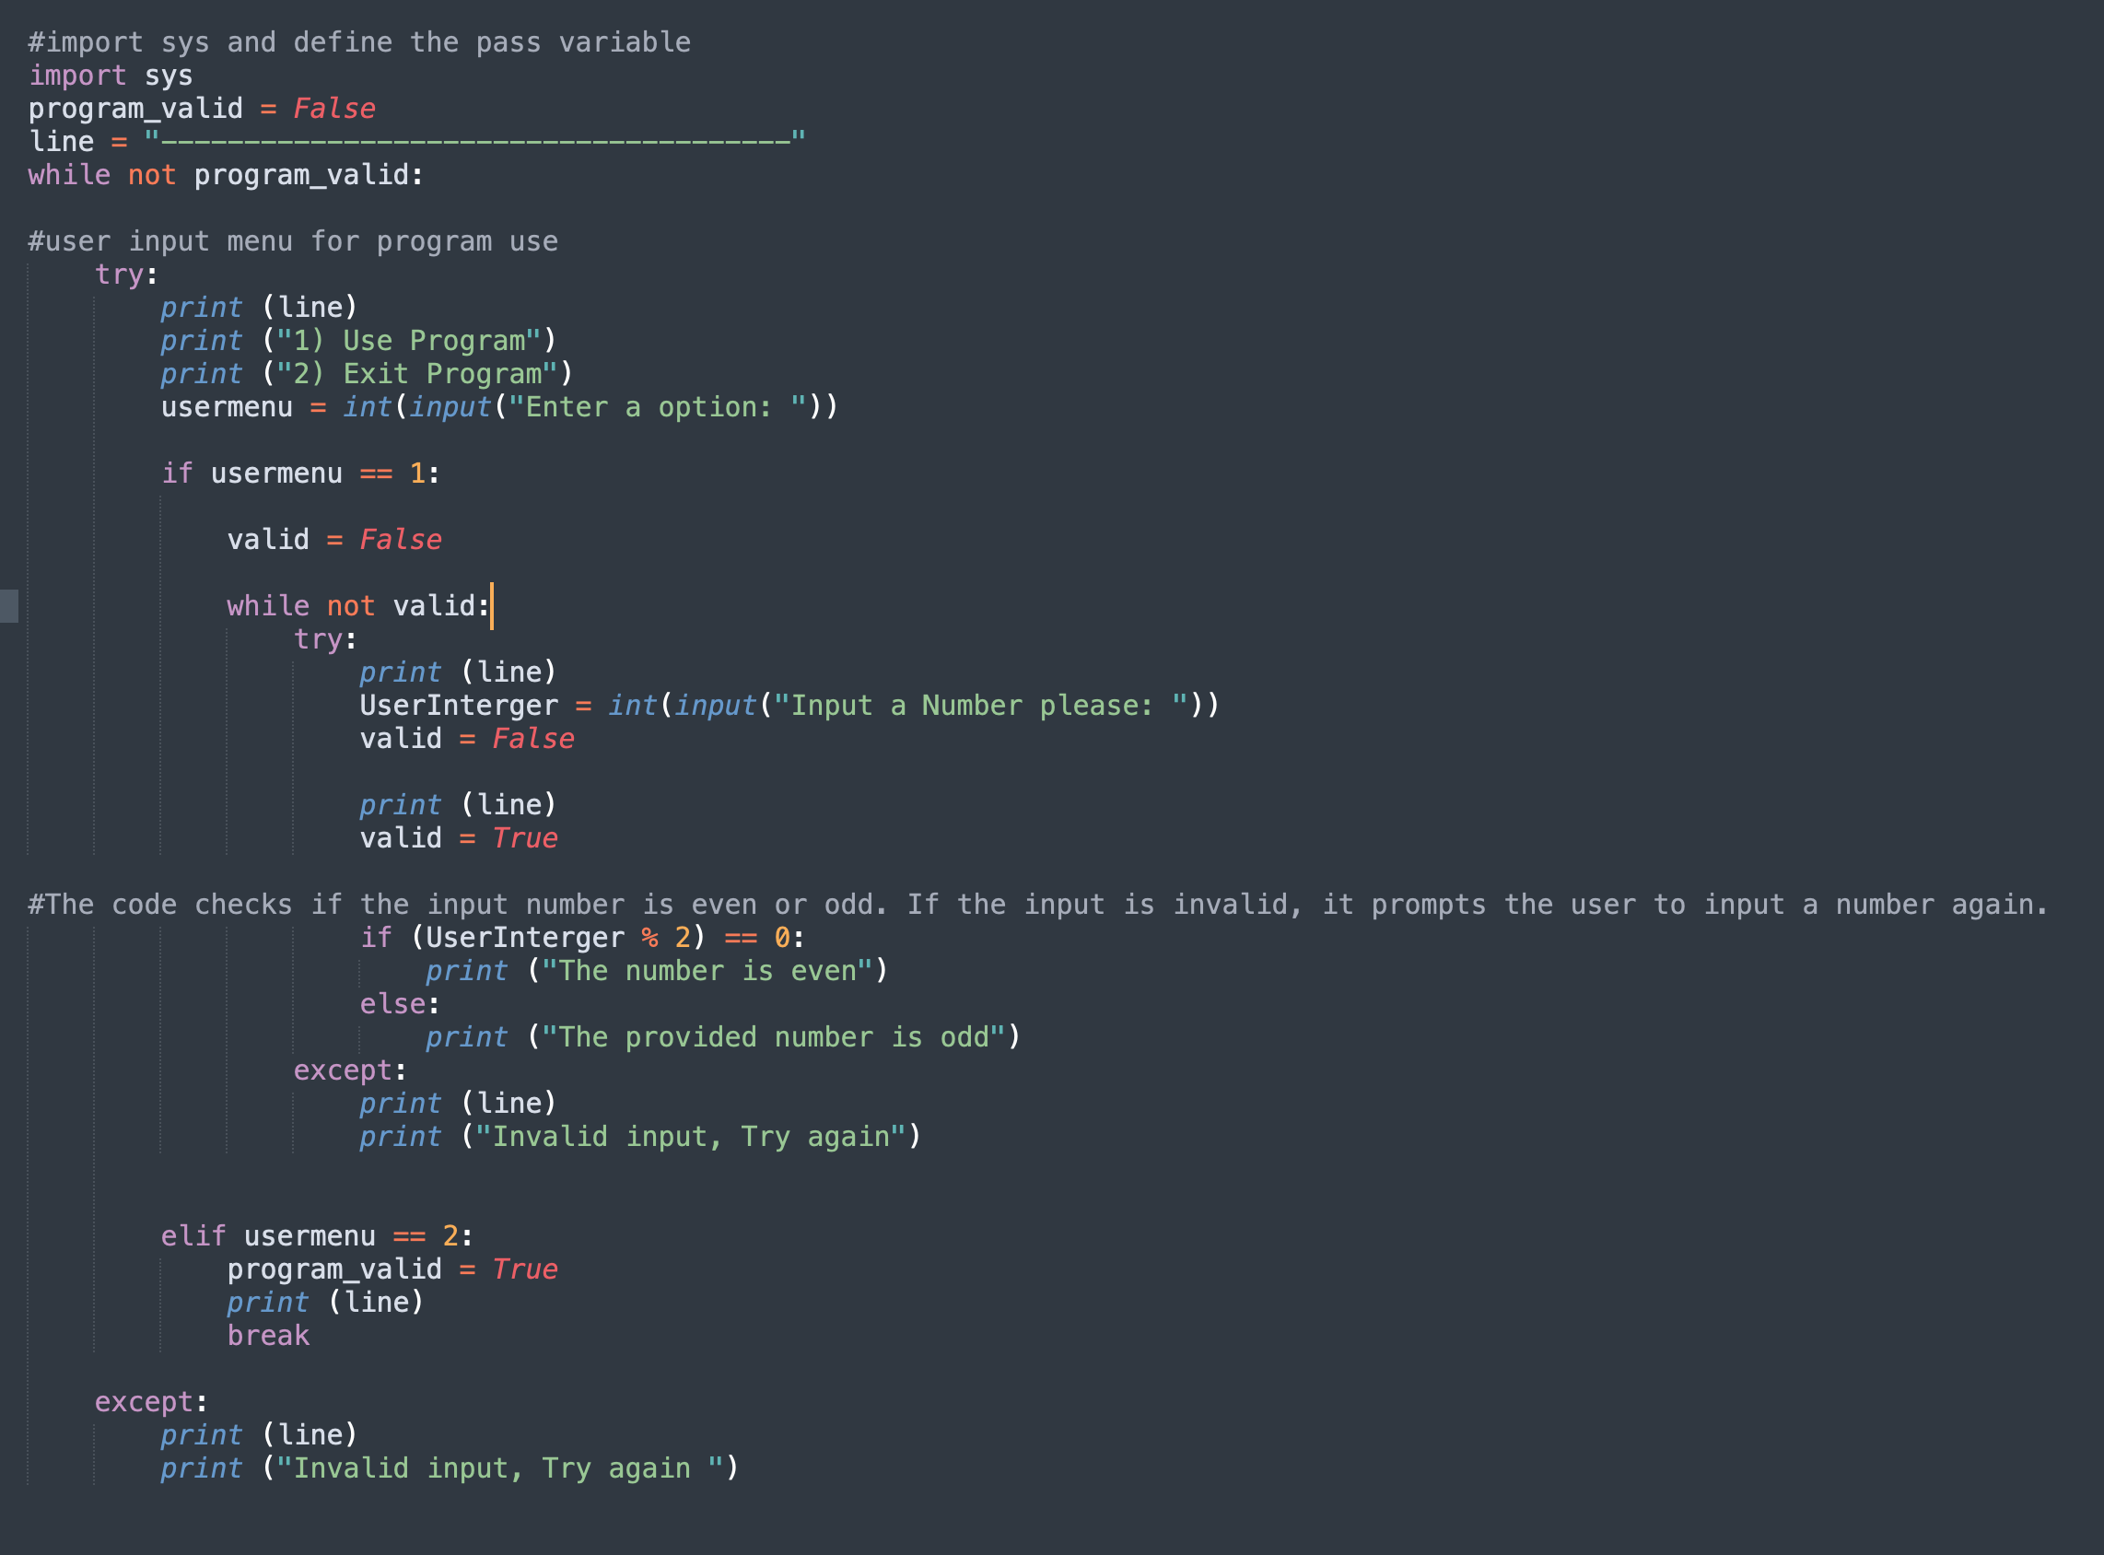
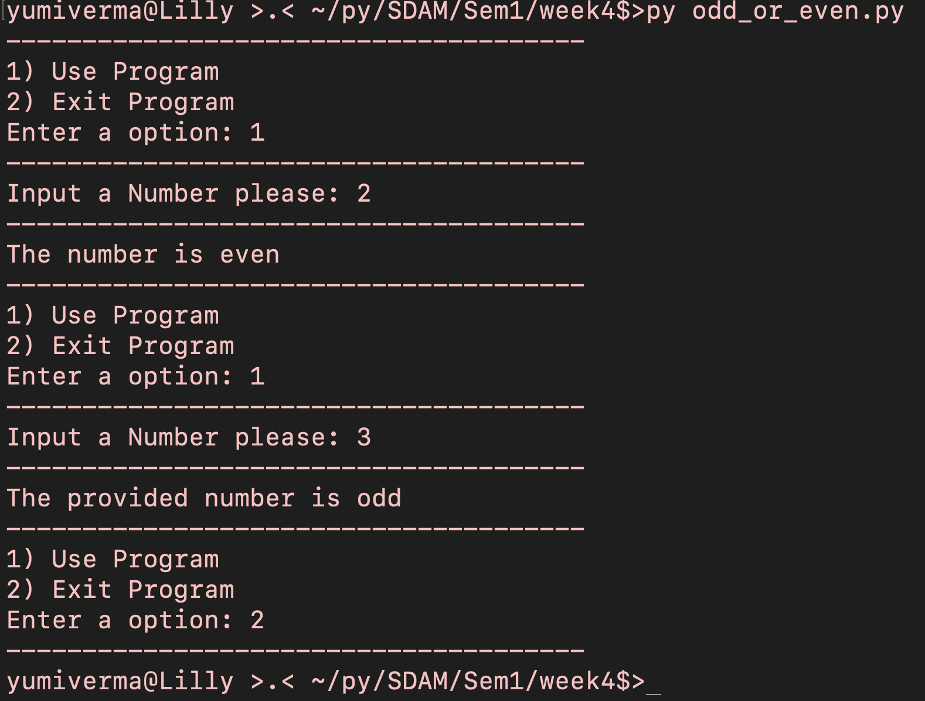
Task 2
#import sys and define the pass variable
import sys
program_valid = False
line = "--------------------------------------"
while not program_valid:
#user input menu for program use
try:
print (line)
print ("1) Use Program")
print ("2) Exit Program")
usermenu = int(input("Enter a option: "))
if usermenu == 1:
valid = False
while not valid:
try:
print (line)
UserInterger = int(input("Input a Number please: "))
valid = False
print (line)
valid = True
#The code checks if the input number is even or odd. If the input is invalid, it prompts the user to input a number again.
if (UserInterger % 2) == 0:
print ("The number is even")
else:
print ("The provided number is odd")
except:
print (line)
print ("Invalid input, Try again")
elif usermenu == 2:
program_valid = True
print (line)
break
except:
print (line)
print ("Invalid input, Try again ")

Slide 4
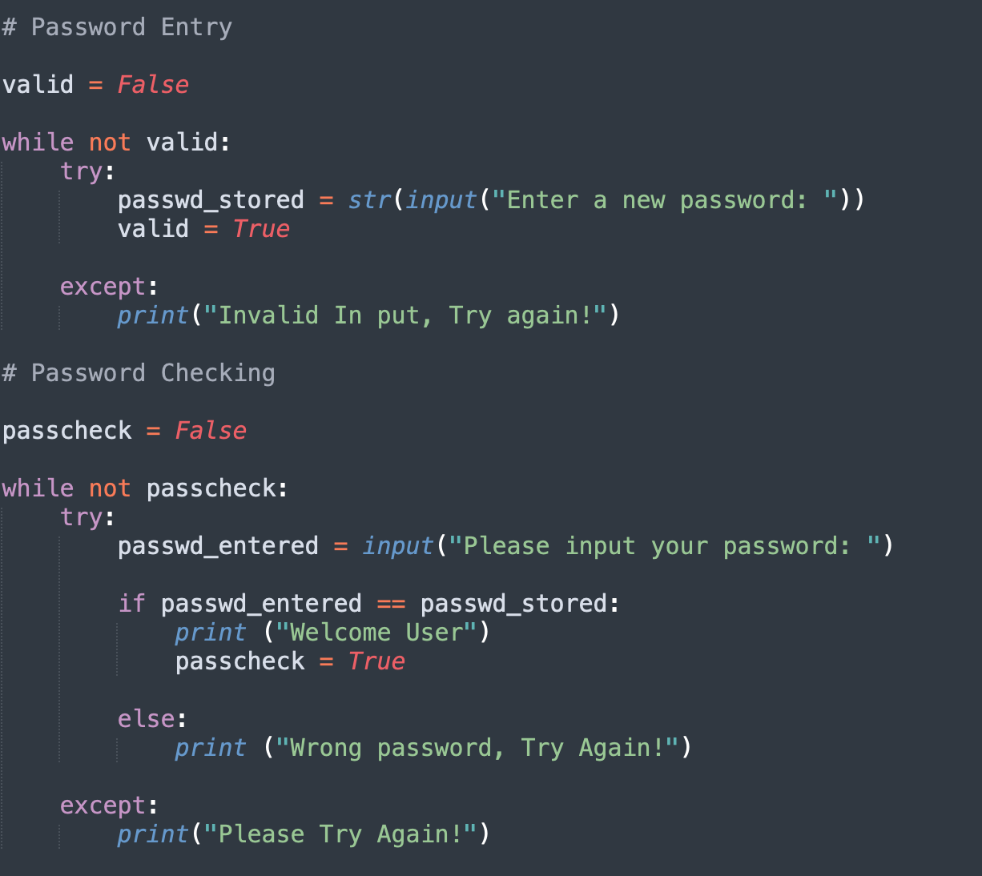
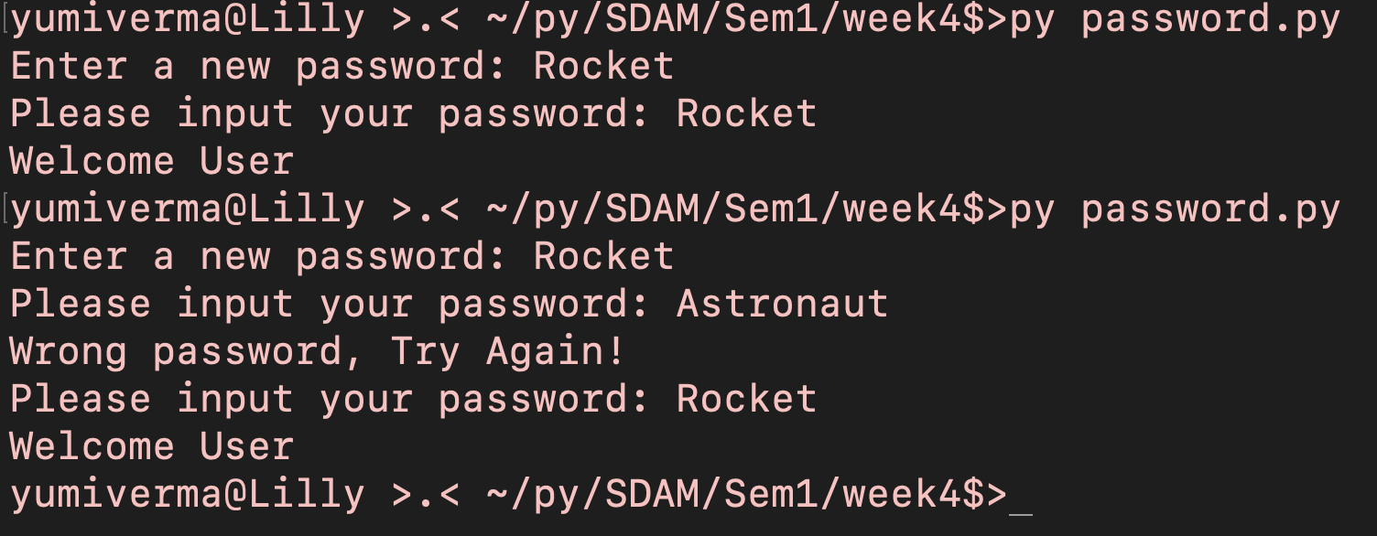
Task 3
# Password Entry
valid = False
while not valid:
try:
passwd_stored = str(input("Enter a new password: "))
valid = True
except:
print("Invalid In put, Try again!")
# Password Checking
passcheck = False
while not passcheck:
try:
passwd_entered = input("Please input your password: ")
if passwd_entered == passwd_stored:
print ("Welcome User")
passcheck = True
else:
print ("Wrong password, Try Again!")
except:
print("Please Try Again!")

Slide 5
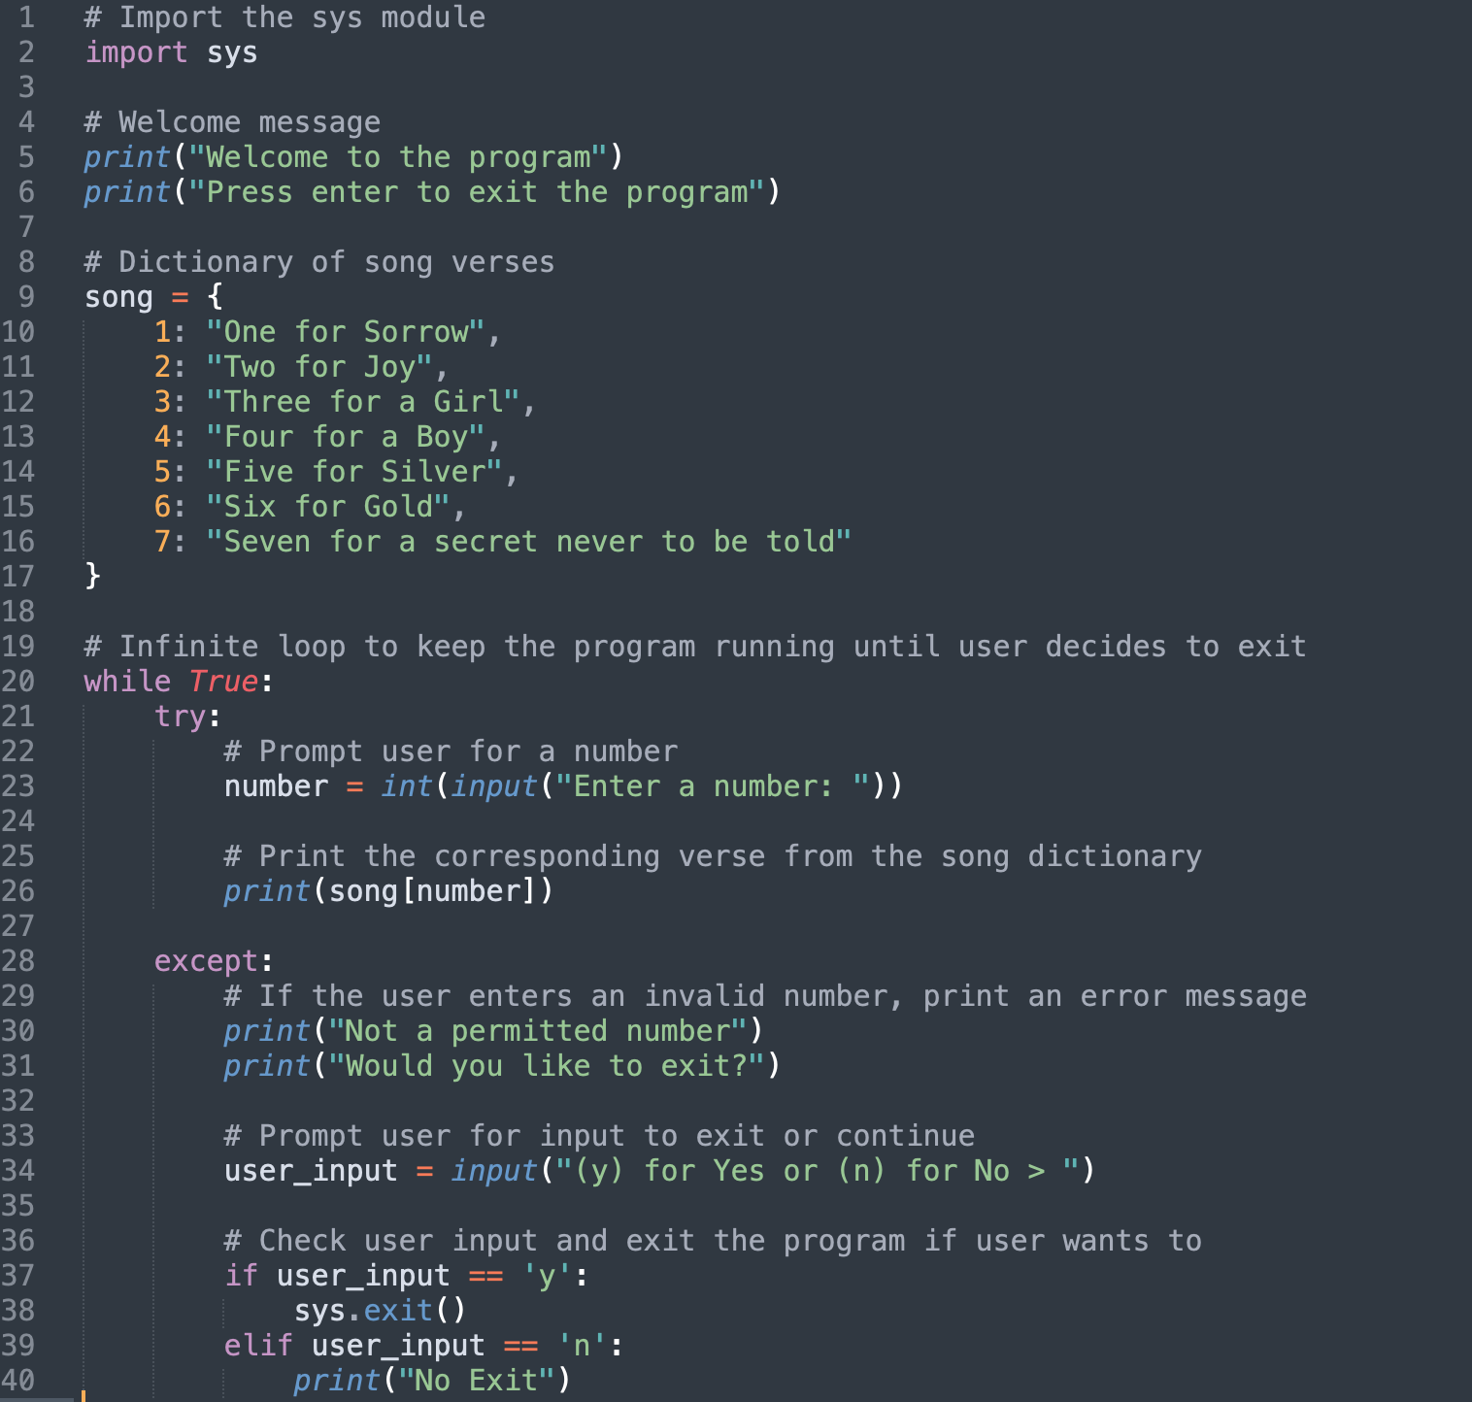
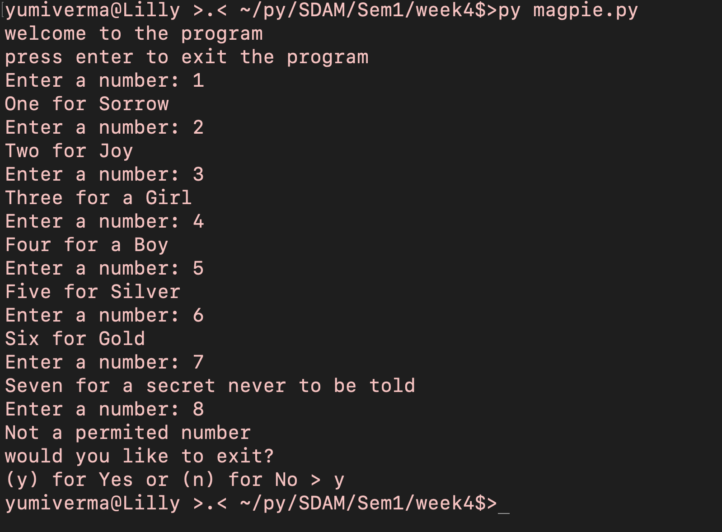
Task 4
# Import the sys module
import sys
# Welcome message
print("Welcome to the program")
print("Press enter to exit the program")
# Dictionary of song verses
song = {
1: "One for Sorrow",
2: "Two for Joy",
3: "Three for a Girl",
4: "Four for a Boy",
5: "Five for Silver",
6: "Six for Gold",
7: "Seven for a secret never to be told"
}
# Infinite loop to keep the program running until user decides to exit
while True:
try:
# Prompt user for a number
number = int(input("Enter a number: "))
# Print the corresponding verse from the song dictionary
print(song[number])
except:
# If the user enters an invalid number, print an error message
print("Not a permitted number")
print("Would you like to exit?")
# Prompt user for input to exit or continue
user_input = input("(y) for Yes or (n) for No > ")
# Check user input and exit the program if user wants to
if user_input == 'y':
sys.exit()
elif user_input == 'n':
print("No Exit")

Slide 6
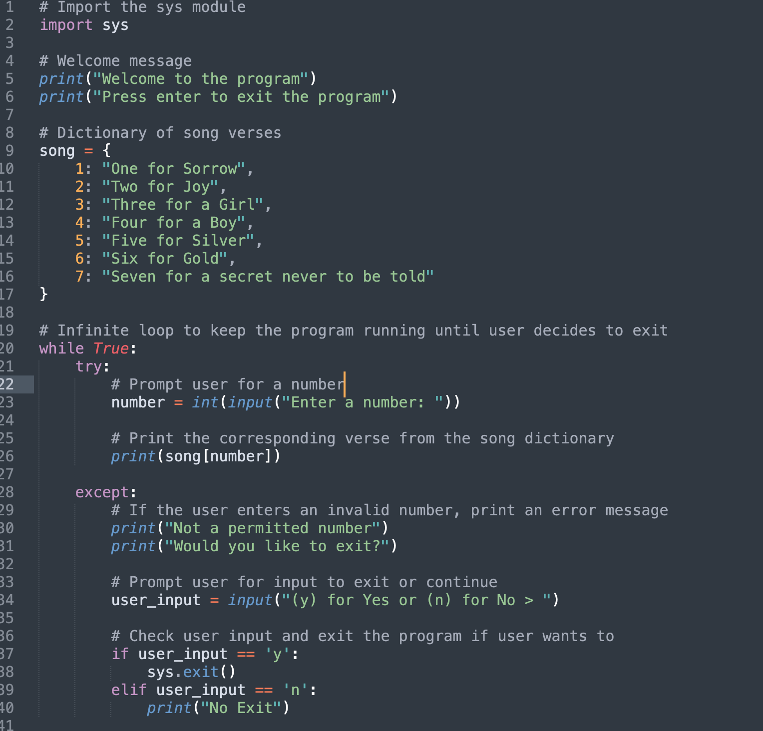
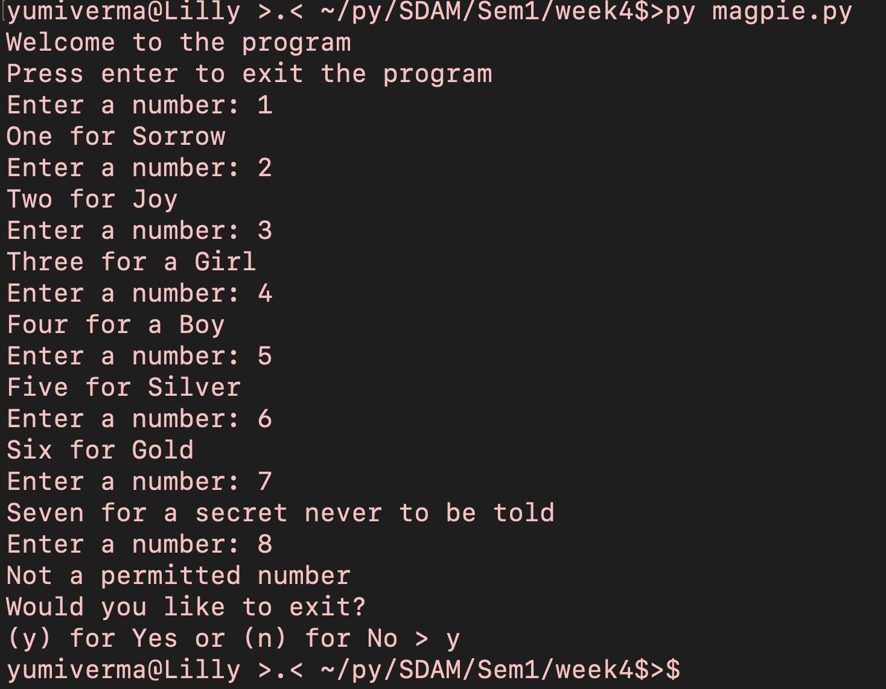
Task 4
# Import the sys module
import sys
# Welcome message
print("Welcome to the program")
print("Press enter to exit the program")
# Dictionary of song verses
song = {
1: "One for Sorrow",
2: "Two for Joy",
3: "Three for a Girl",
4: "Four for a Boy",
5: "Five for Silver",
6: "Six for Gold",
7: "Seven for a secret never to be told"
}
# Infinite loop to keep the program running until user decides to exit
while True:
try:
# Prompt user for a number
number = int(input("Enter a number: "))
# Print the corresponding verse from the song dictionary
print(song[number])
except:
# If the user enters an invalid number, print an error message
print("Not a permitted number")
print("Would you like to exit?")
# Prompt user for input to exit or continue
user_input = input("(y) for Yes or (n) for No > ")
# Check user input and exit the program if user wants to
if user_input == 'y':
sys.exit()
elif user_input == 'n':
print("No Exit")

Slide 7
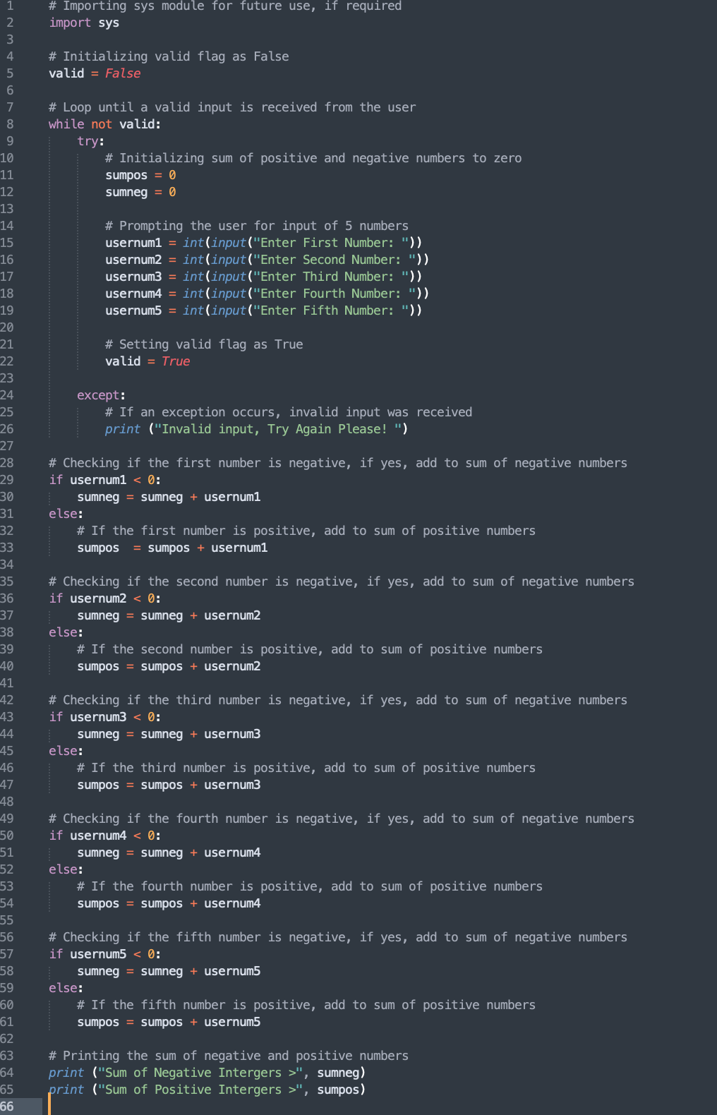
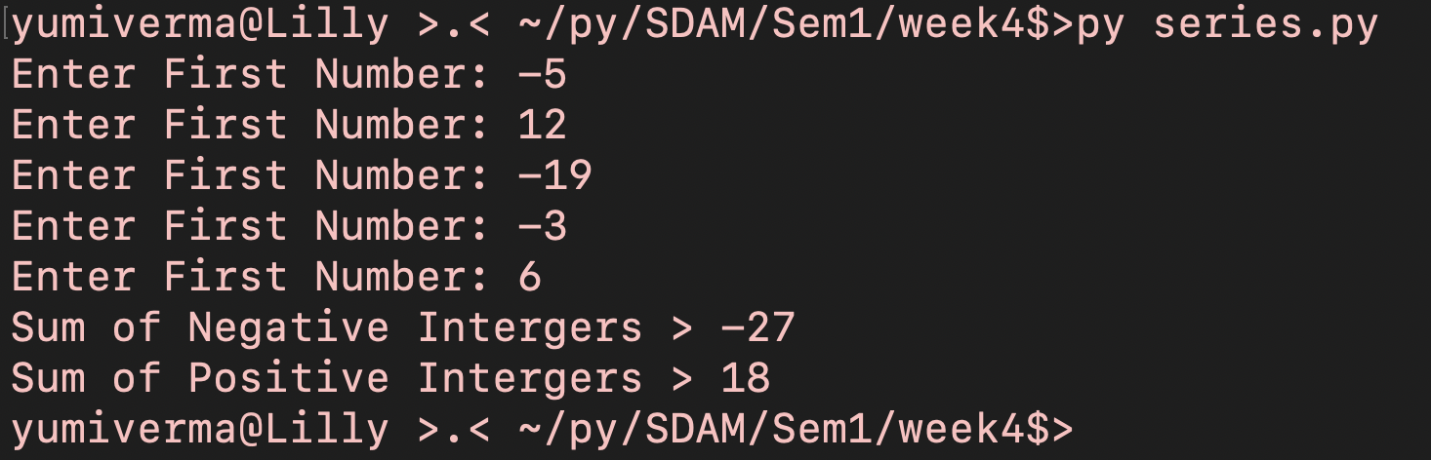
Task5
# Importing sys module for future use, if required
import sys
# Initializing valid flag as False
valid = False
# Loop until a valid input is received from the user
while not valid:
try:
# Initializing sum of positive and negative numbers to zero
sumpos = 0
sumneg = 0
# Prompting the user for input of 5 numbers
usernum1 = int(input("Enter First Number: "))
usernum2 = int(input("Enter Second Number: "))
usernum3 = int(input("Enter Third Number: "))
usernum4 = int(input("Enter Fourth Number: "))
usernum5 = int(input("Enter Fifth Number: "))
# Setting valid flag as True
valid = True
except:
# If an exception occurs, invalid input was received
print ("Invalid input, Try Again Please! ")
# Checking if the first number is negative, if yes, add to sum of negative numbers
if usernum1 < 0:
sumneg = sumneg + usernum1
else:
# If the first number is positive, add to sum of positive numbers
sumpos = sumpos + usernum1
# Checking if the second number is negative, if yes, add to sum of negative numbers
if usernum2 < 0:
sumneg = sumneg + usernum2
else:
# If the second number is positive, add to sum of positive numbers
sumpos = sumpos + usernum2
# Checking if the third number is negative, if yes, add to sum of negative numbers
if usernum3 < 0:
sumneg = sumneg + usernum3
else:
# If the third number is positive, add to sum of positive numbers
sumpos = sumpos + usernum3
# Checking if the fourth number is negative, if yes, add to sum of negative numbers
if usernum4 < 0:
sumneg = sumneg + usernum4
else:
# If the fourth number is positive, add to sum of positive numbers
sumpos = sumpos + usernum4
# Checking if the fifth number is negative, if yes, add to sum of negative numbers
if usernum5 < 0:
sumneg = sumneg + usernum5
else:
# If the fifth number is positive, add to sum of positive numbers
sumpos = sumpos + usernum5
# Printing the sum of negative and positive numbers
print ("Sum of Negative Intergers >", sumneg)
print ("Sum of Positive Intergers >", sumpos)

Slide 8
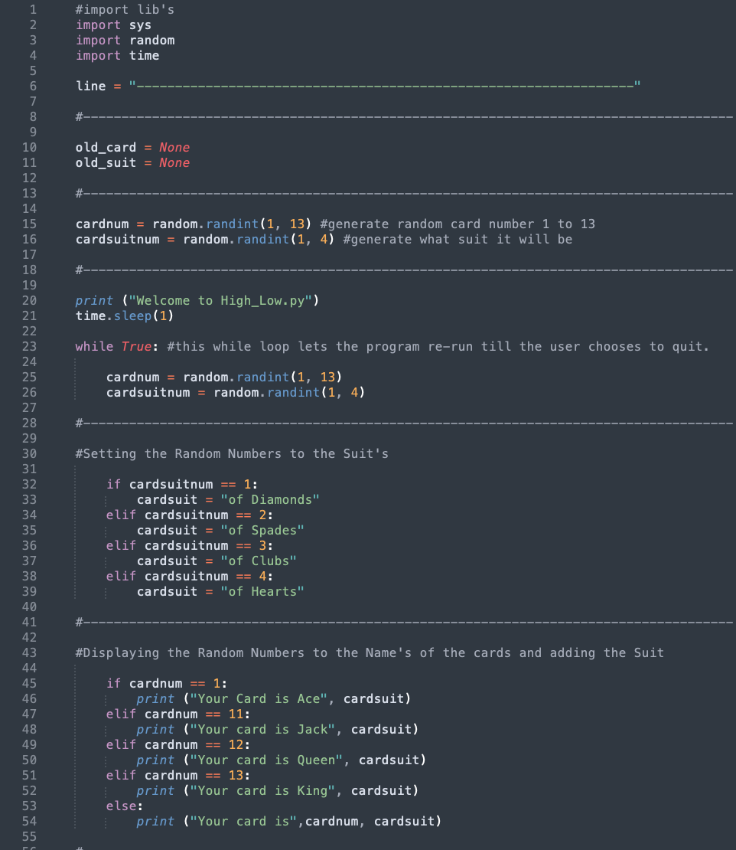
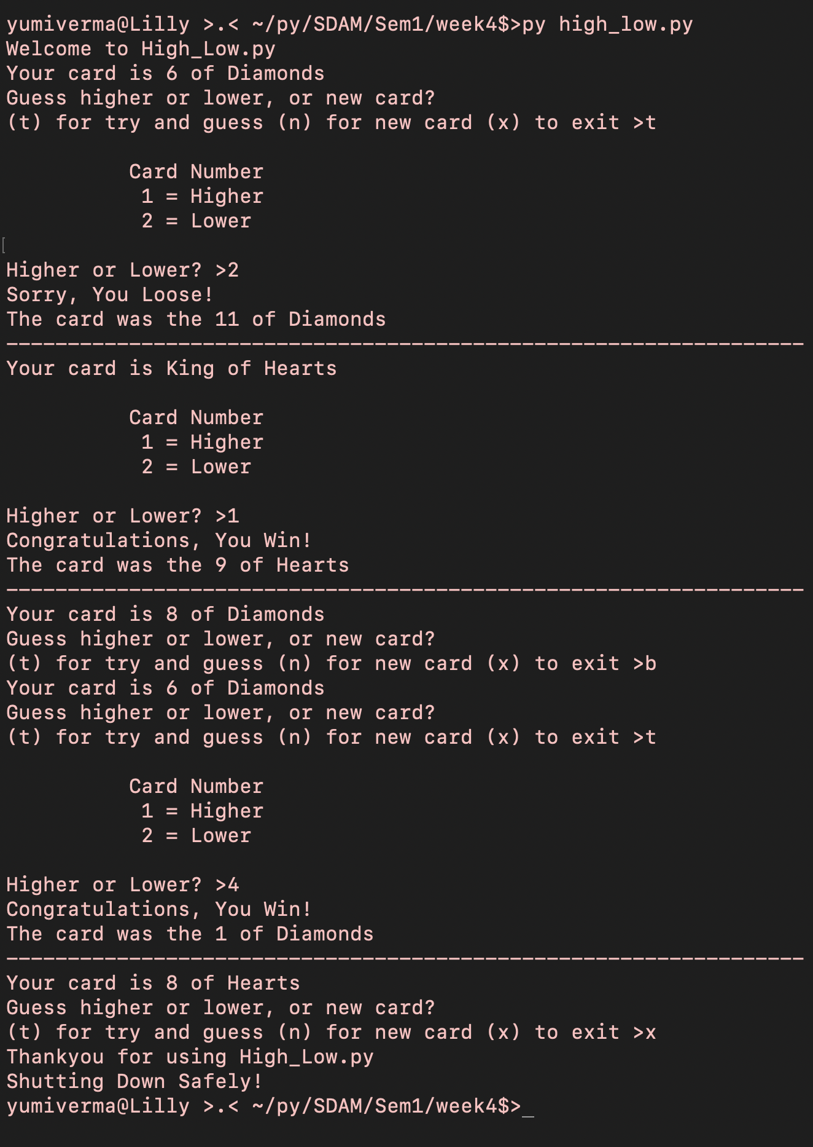
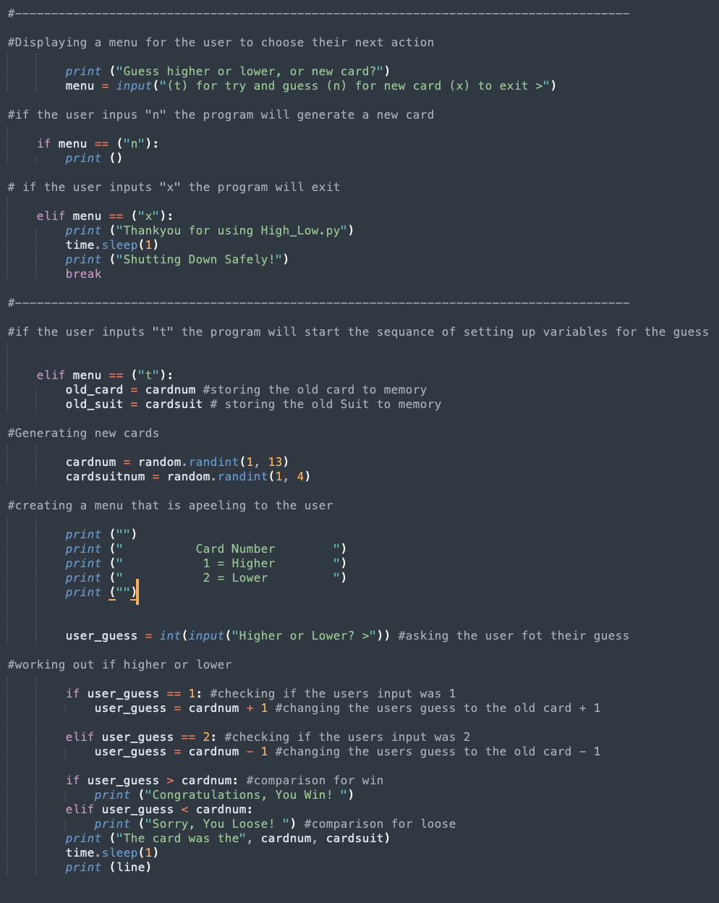
Task 6
#import lib's
import sys
import random
import time
line = "-----------------------------------------------------------------"
#-------------------------------------------------------------------------------------
old_card = None
old_suit = None
#-------------------------------------------------------------------------------------
cardnum = random.randint(1, 13) #generate random card number 1 to 13
cardsuitnum = random.randint(1, 4) #generate what suit it will be
#-------------------------------------------------------------------------------------
print ("Welcome to High_Low.py")
time.sleep(1)
while True: #this while loop lets the program re-run till the user chooses to quit.
cardnum = random.randint(1, 13)
cardsuitnum = random.randint(1, 4)
#-------------------------------------------------------------------------------------
#Setting the Random Numbers to the Suit's
if cardsuitnum == 1:
cardsuit = "of Diamonds"
elif cardsuitnum == 2:
cardsuit = "of Spades"
elif cardsuitnum == 3:
cardsuit = "of Clubs"
elif cardsuitnum == 4:
cardsuit = "of Hearts"
#-------------------------------------------------------------------------------------
#Displaying the Random Numbers to the Name's of the cards and adding the Suit
if cardnum == 1:
print ("Your Card is Ace", cardsuit)
elif cardnum == 11:
print ("Your card is Jack", cardsuit)
elif cardnum == 12:
print ("Your card is Queen", cardsuit)
elif cardnum == 13:
print ("Your card is King", cardsuit)
else:
print ("Your card is",cardnum, cardsuit)
#-------------------------------------------------------------------------------------
#Displaying a menu for the user to choose their next action
print ("Guess higher or lower, or new card?")
menu = input("(t) for try and guess (n) for new card (x) to exit >")
#if the user inpus "n" the program will generate a new card
if menu == ("n"):
print ()
# if the user inputs "x" the program will exit
elif menu == ("x"):
print ("Thankyou for using High_Low.py")
time.sleep(1)
print ("Shutting Down Safely!")
break
#-------------------------------------------------------------------------------------
#if the user inputs "t" the program will start the sequance of setting up variables for the guess
elif menu == ("t"):
old_card = cardnum #storing the old card to memory
old_suit = cardsuit # storing the old Suit to memory
#Generating new cards
cardnum = random.randint(1, 13)
cardsuitnum = random.randint(1, 4)
#creating a menu that is apeeling to the user
print ("")
print (" Card Number ")
print (" 1 = Higher ")
print (" 2 = Lower ")
print ("")
user_guess = int(input("Higher or Lower? >")) #asking the user fot their guess
#working out if higher or lower
if user_guess == 1: #checking if the users input was 1
user_guess = cardnum + 1 #changing the users guess to the old card + 1
elif user_guess == 2: #checking if the users input was 2
user_guess = cardnum - 1 #changing the users guess to the old card - 1
if user_guess > cardnum: #comparison for win
print ("Congratulations, You Win! ")
elif user_guess < cardnum:
print ("Sorry, You Loose! ") #comparison for loose
print ("The card was the", cardnum, cardsuit)
time.sleep(1)
print (line)

